Slide 1
Software Engineering and Human Computer Interaction
Than Quang Minh
thanqminh.com
Course URL: /courses/sehci

Slide 2
Today’s topics: Usability (cont.)
Mindless choices
Omit needless word
Website navigation

Slide 3



Scent from a mall

Slide 4
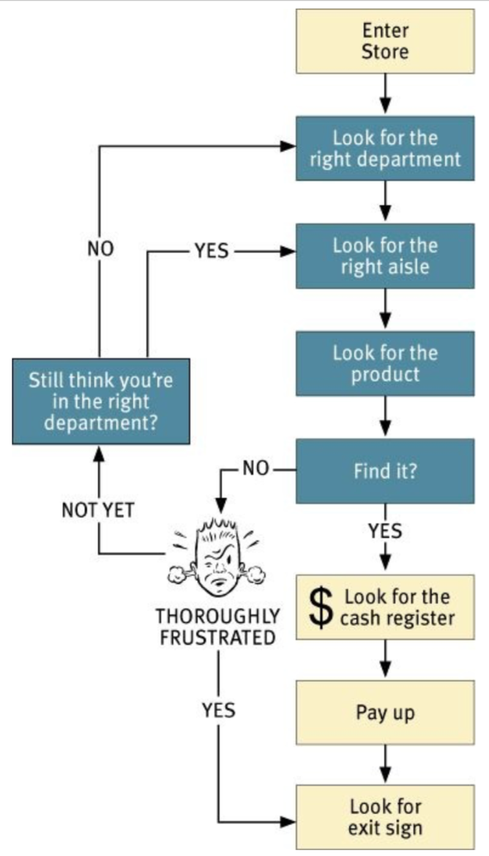

Slide 5
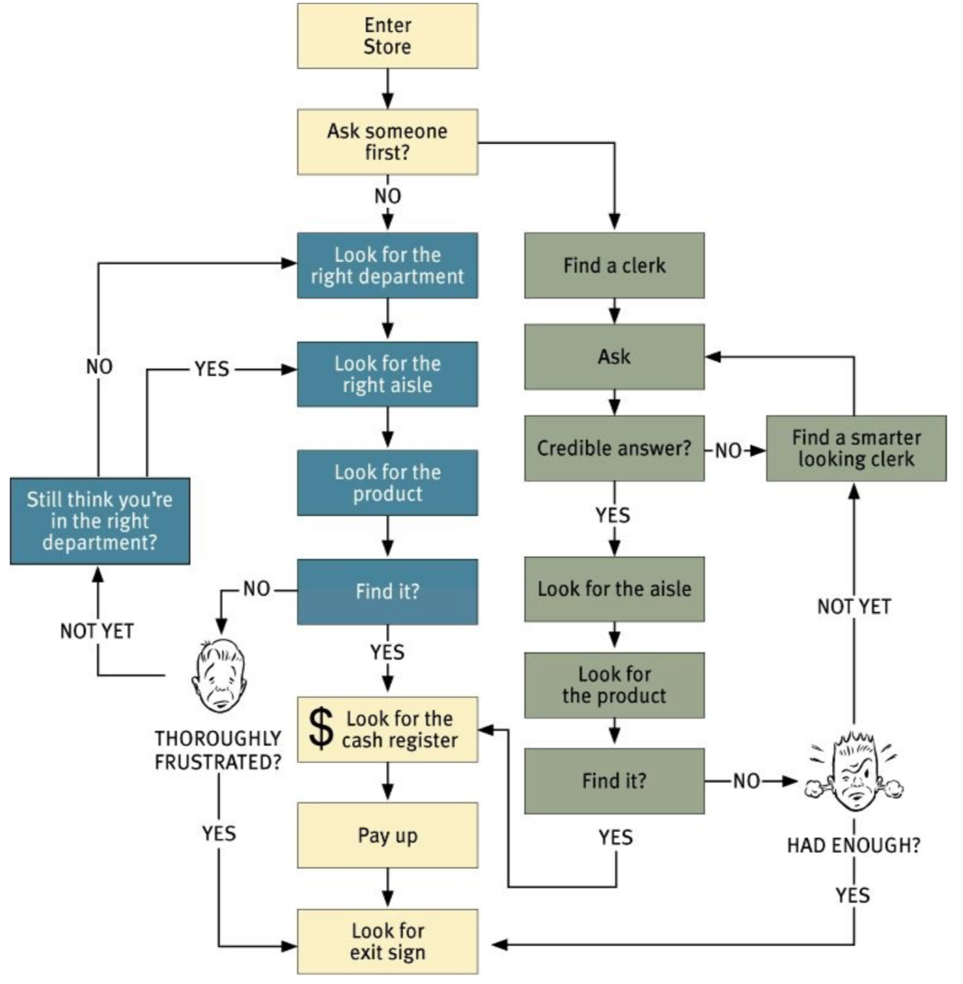

Slide 6
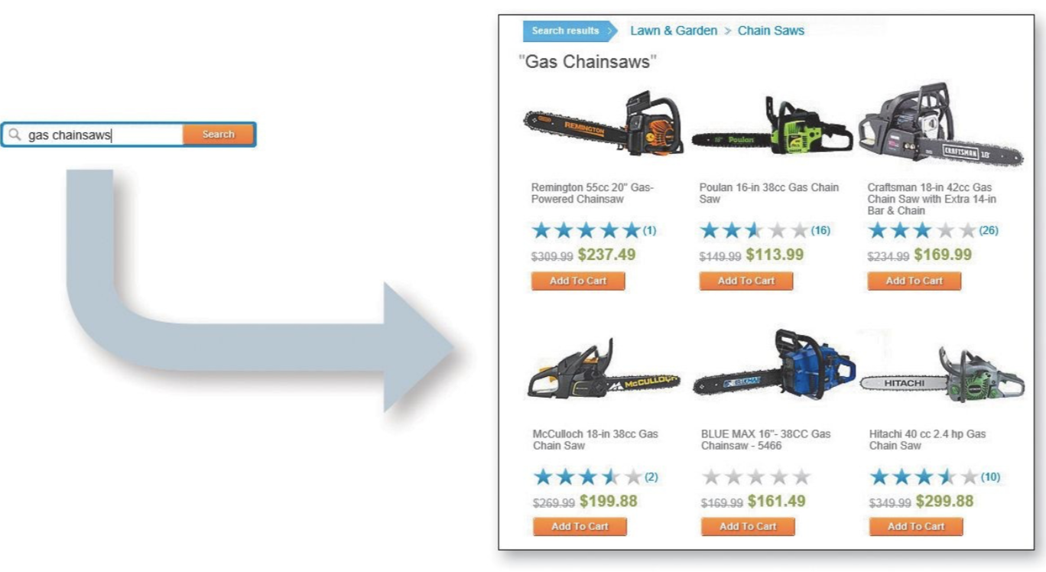
Web Navigation 101
You’re usually try to find something
You decide whether to ask first or browse frist

Slide 7

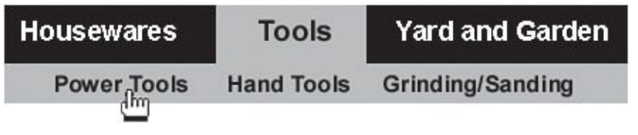
If you choose to browse, you make your way through a hierarchy, using signs to guide you.
Eventually, if you can’t find what you’re looking for, you’ll leave.

Slide 8
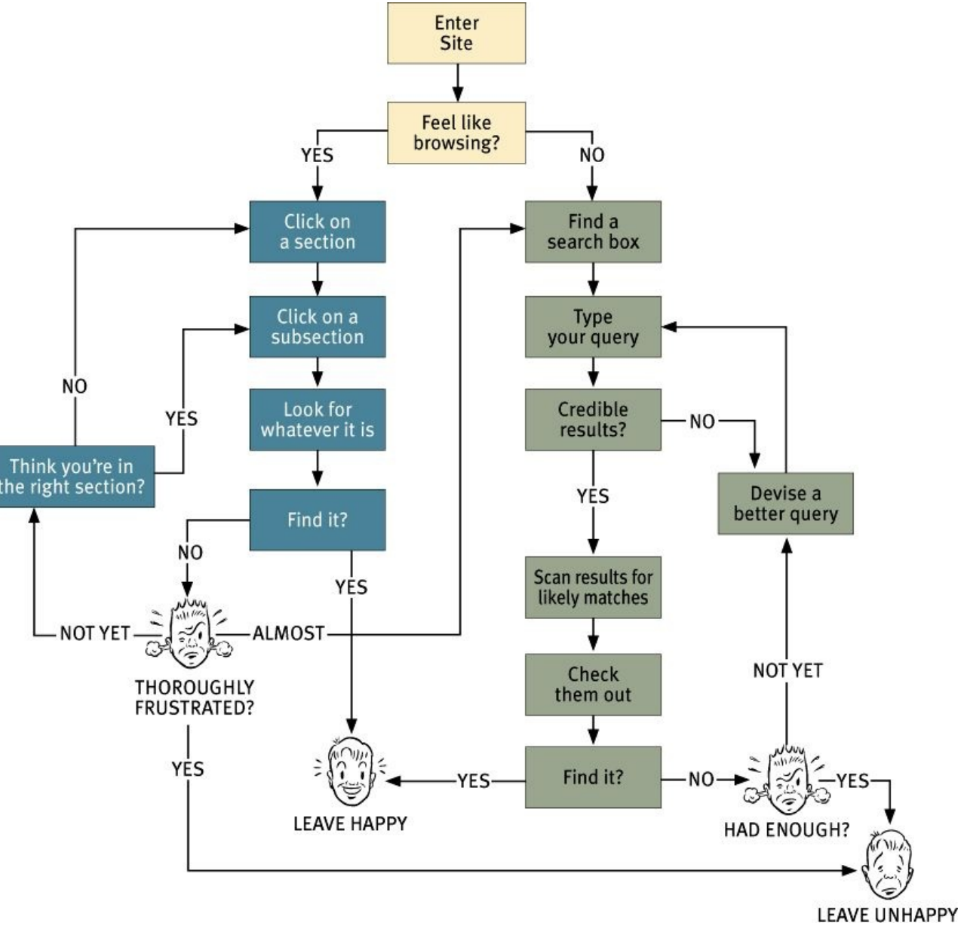

Slide 9
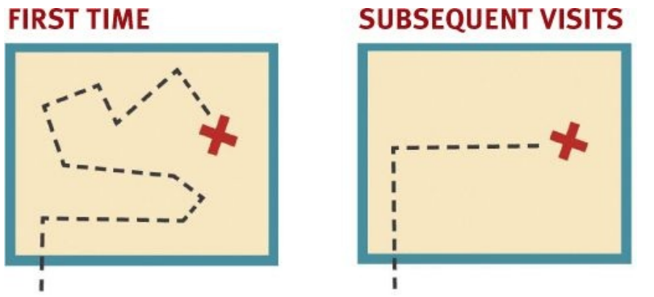
The unbearable lightness of browsing
Bookmarks are important
Home page is fixed place.
Figuring out where you are is a much more pervasive problem
Oddities of Web spaces:
No sense of scale.
No sense of direction
No sense of location.

Slide 10
Purposes of Navigation
whatever it is we’re looking for
and where we are.
what’s here
how to use the site
confidence in the people who built it.

Slide 11
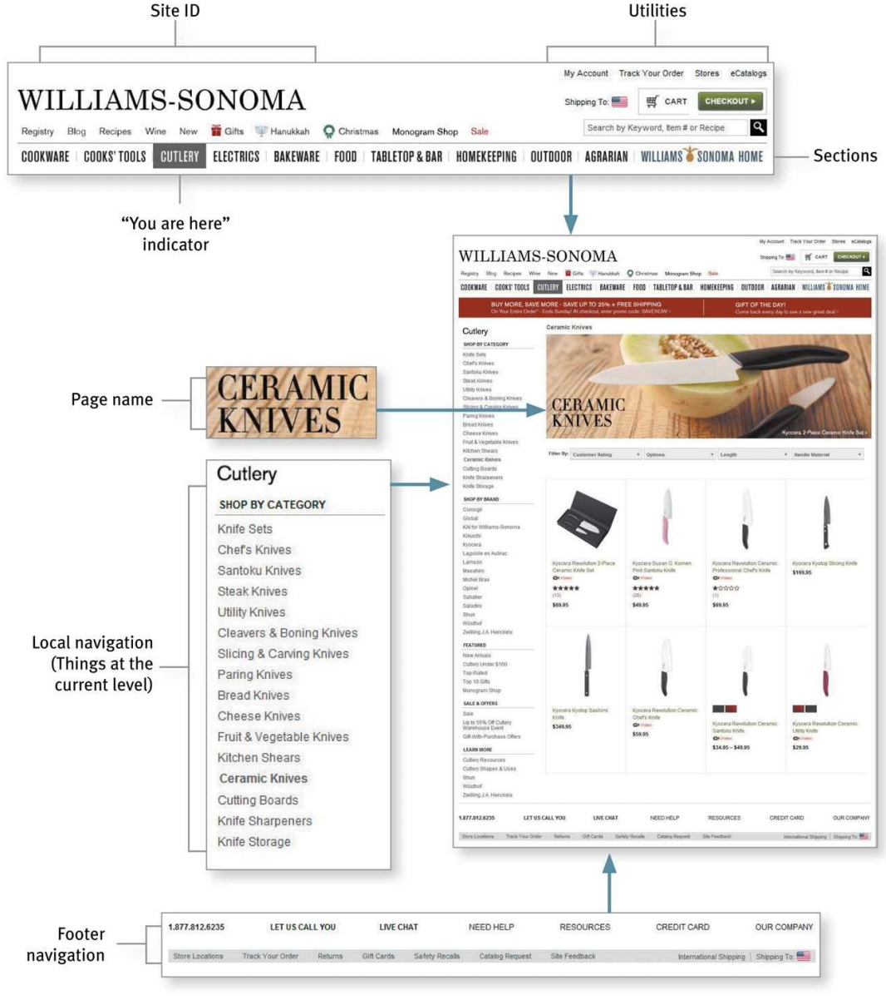

Slide 12
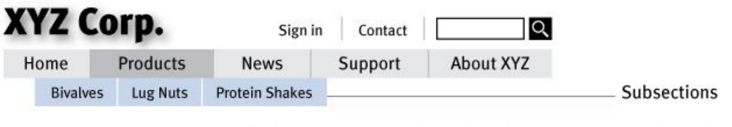

Web navigation conventions
Persistent navigation (global navigation): appears everywhere, except… forms.
The Section (sometimes called primary navigation)
Utilities: Login, contact, about us, downloads, jobs, etc.
“There is no place like home”: site ID as button to homepage.

Slide 13



A way to search
Avoid fancy wording: find, quick find, keyword search, etc.
Avoid giving instructions
Give options to scope the search when it’s useful

Slide 14
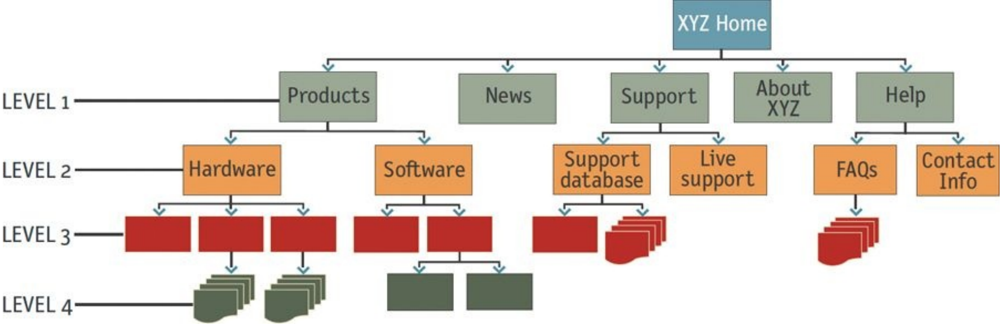
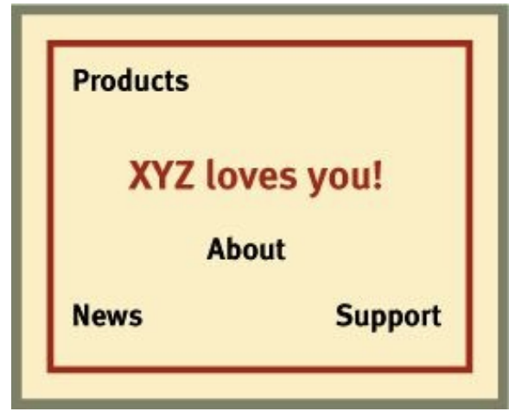
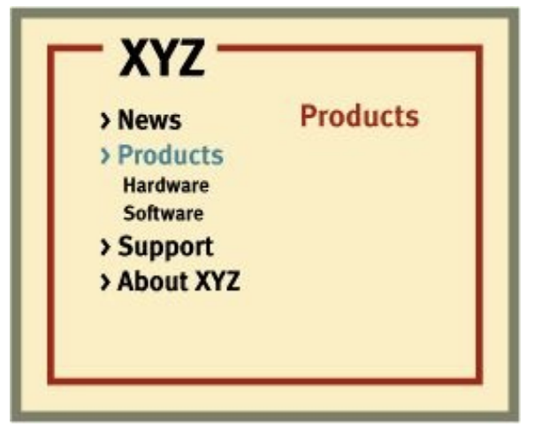
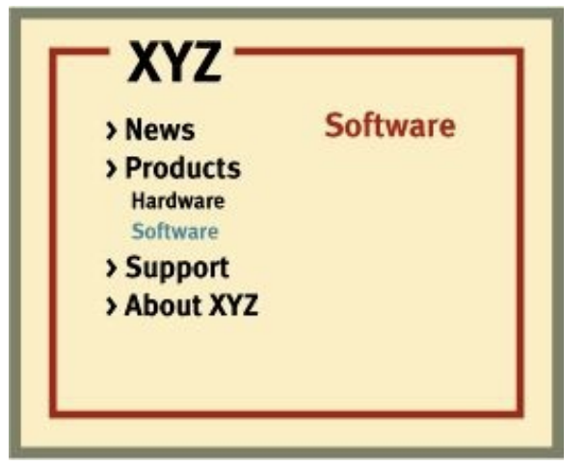
Secondary, tertiary, and whatever comes after tertiary

Slide 15
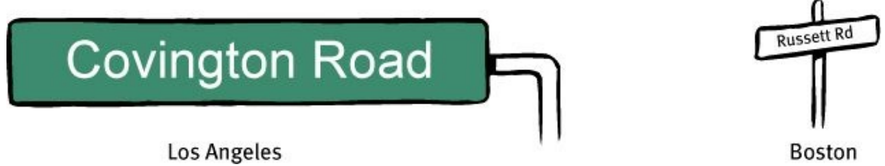
Page names
Why I love to drive in L.A.Street:
signs are big
They’re in the right place
4 things you need to know about page names:
Every page needs a name
The name needs to be in the right place.
The name needs to be prominent
The name needs to match what I clicked.

Slide 16
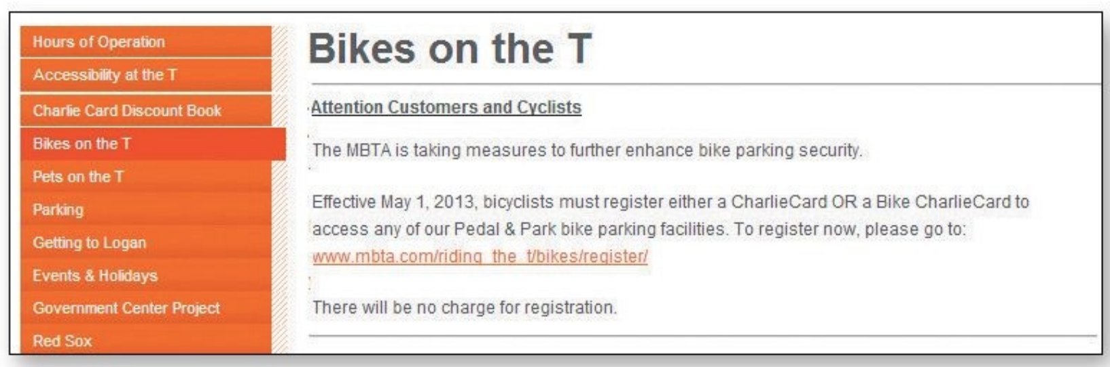
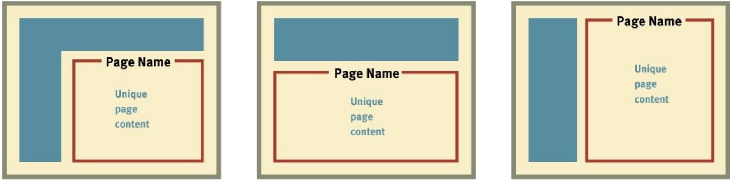
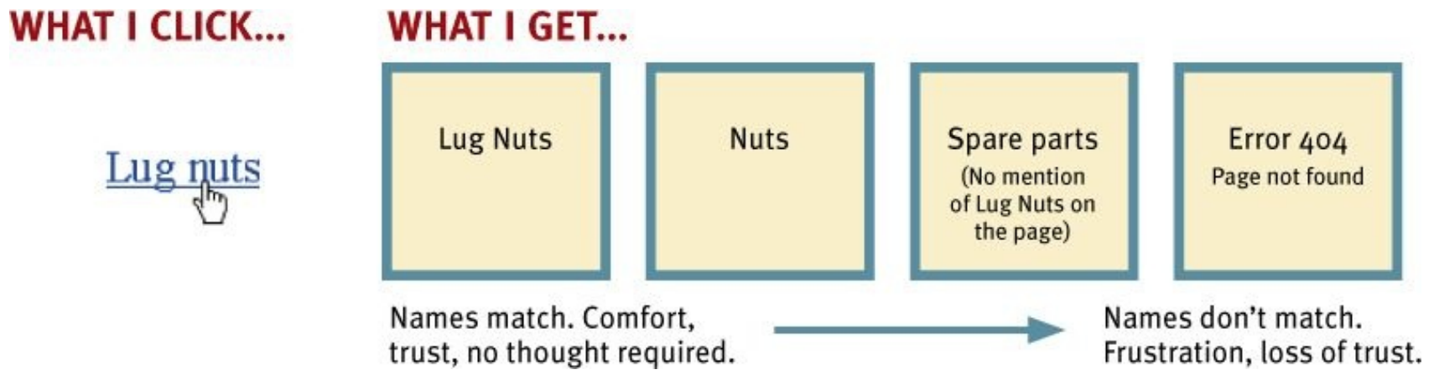

Slide 17
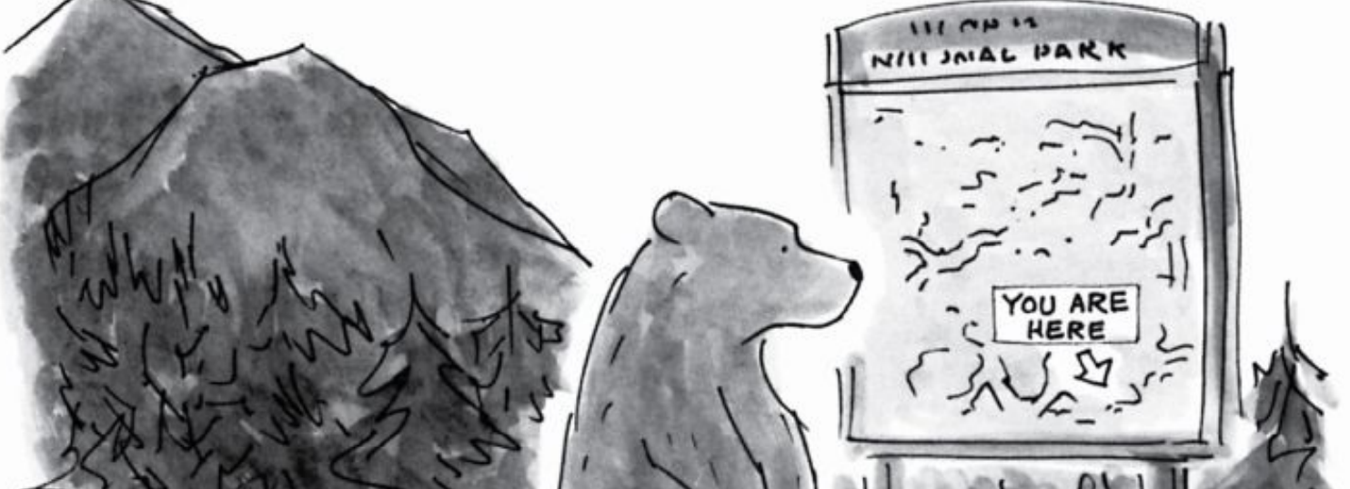
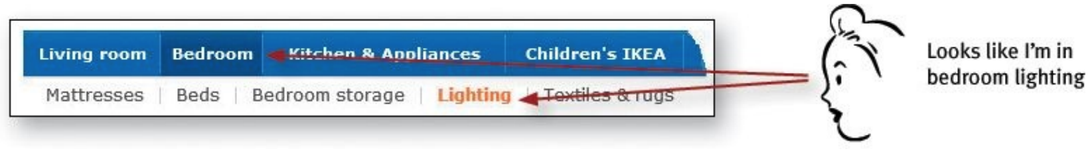
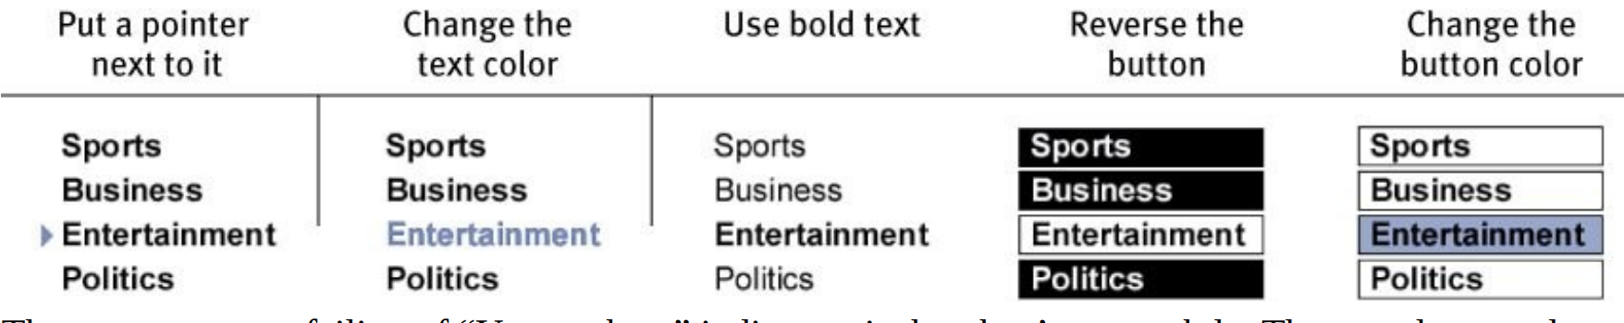
You are here

Slide 18
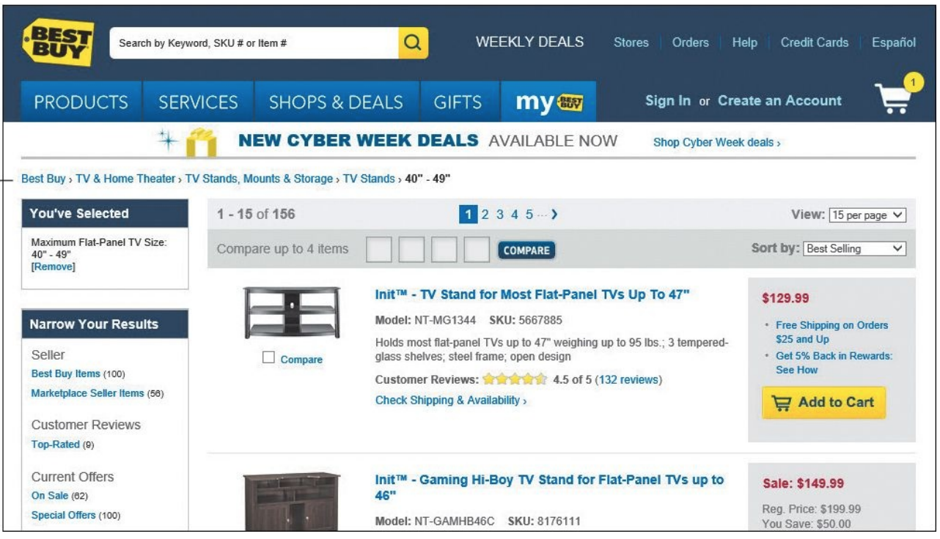
Breadcrumbs: show where you are
Notes:
The trail of crumbs Hansel dropped in the woods so he and Gretel could find their way back home: In the original story, H & G’s stepmother persuades their father to lose them in the forest during lean times so the whole family won’t have to starve. The suspicious and resourceful H spoils the plot by dropping pebbles on the way in and following them home. But the next time (!) H is forced to use breadcrumbs instead, which prove to be a less-than-suitable substitute since birds eat them before H & G can retrace their steps. Eventually the tale devolves into attempted cannibalism, grand larceny, and immolation, but basically it’s a story about how unpleasant it is to be lost

Slide 19
Breadcrumbs: show where you are
The path from the Home page to where you are and make it easy to move back up to higher levels in the hierarchy of a site.
Breadcrumbs are self-explanatory don’t take up much room, provide a convenient, consistent way to do two of the things you need to do most often: back up a level or go Home
They’re most useful in a large site with a deep hierarchy.
Best practices:
Put them at the top
Use > between levels.
Boldface the last item

Slide 20
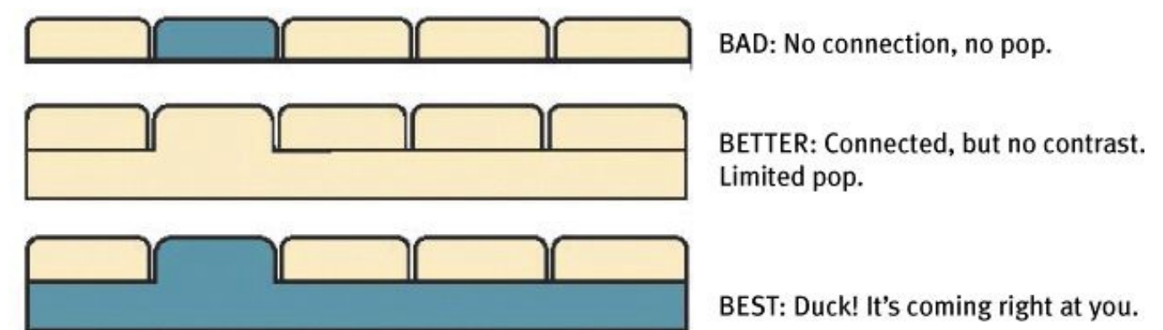
Three reasons why I still love tabs
Physical metaphor in a user interface actually works
They’re self-evident.
They’re hard to miss.
They’re slick.

Slide 21
The trunk test
What site is this? (Site ID)
What page am I on? (Page name)
What are the major sections of this site? (Sections)
What are my options at this level? (Local navigation)
Where am I in the scheme of things? (“You are here” indicators)
How can I search?

Slide 22
How you perform the trunk test
Step 1: Choose a page anywhere in the site at random, and print it.
Step 2: Hold it at arm’s length or squint so you can’t really study it closely.
Step 3: As quickly as possible, try to find and circle each of these items:
Site ID
Page name
Sections (Primary navigation)
Local navigation “You are here” indicator(s)
Search

Slide 23
Designing a Home page: just one...more...thing
Site identity and mission.
Site hierarchy.
Search
Teases
Content promos
Feature promos
Timely content.
Deals
Shortcuts
Registration
Show me what I’m looking for
… and what I’m not looking for
Show me where to start
Establish credibility and trust
Everybody wants a piece of it
Too many cooks
One size fits all.

Slide 24
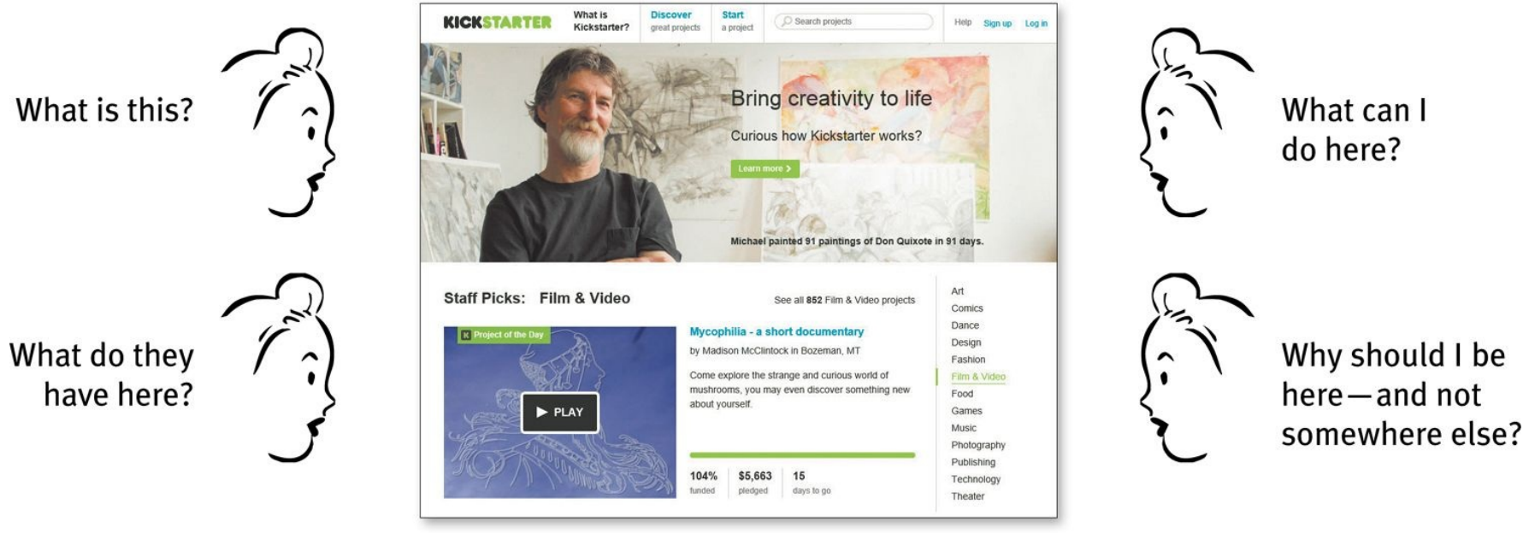
The First Casualty of War
The one thing you can’t afford to lose in the shuffle—and the thing that most often gets lost—is conveying the big picture: made it clear enough what the site is

Slide 25
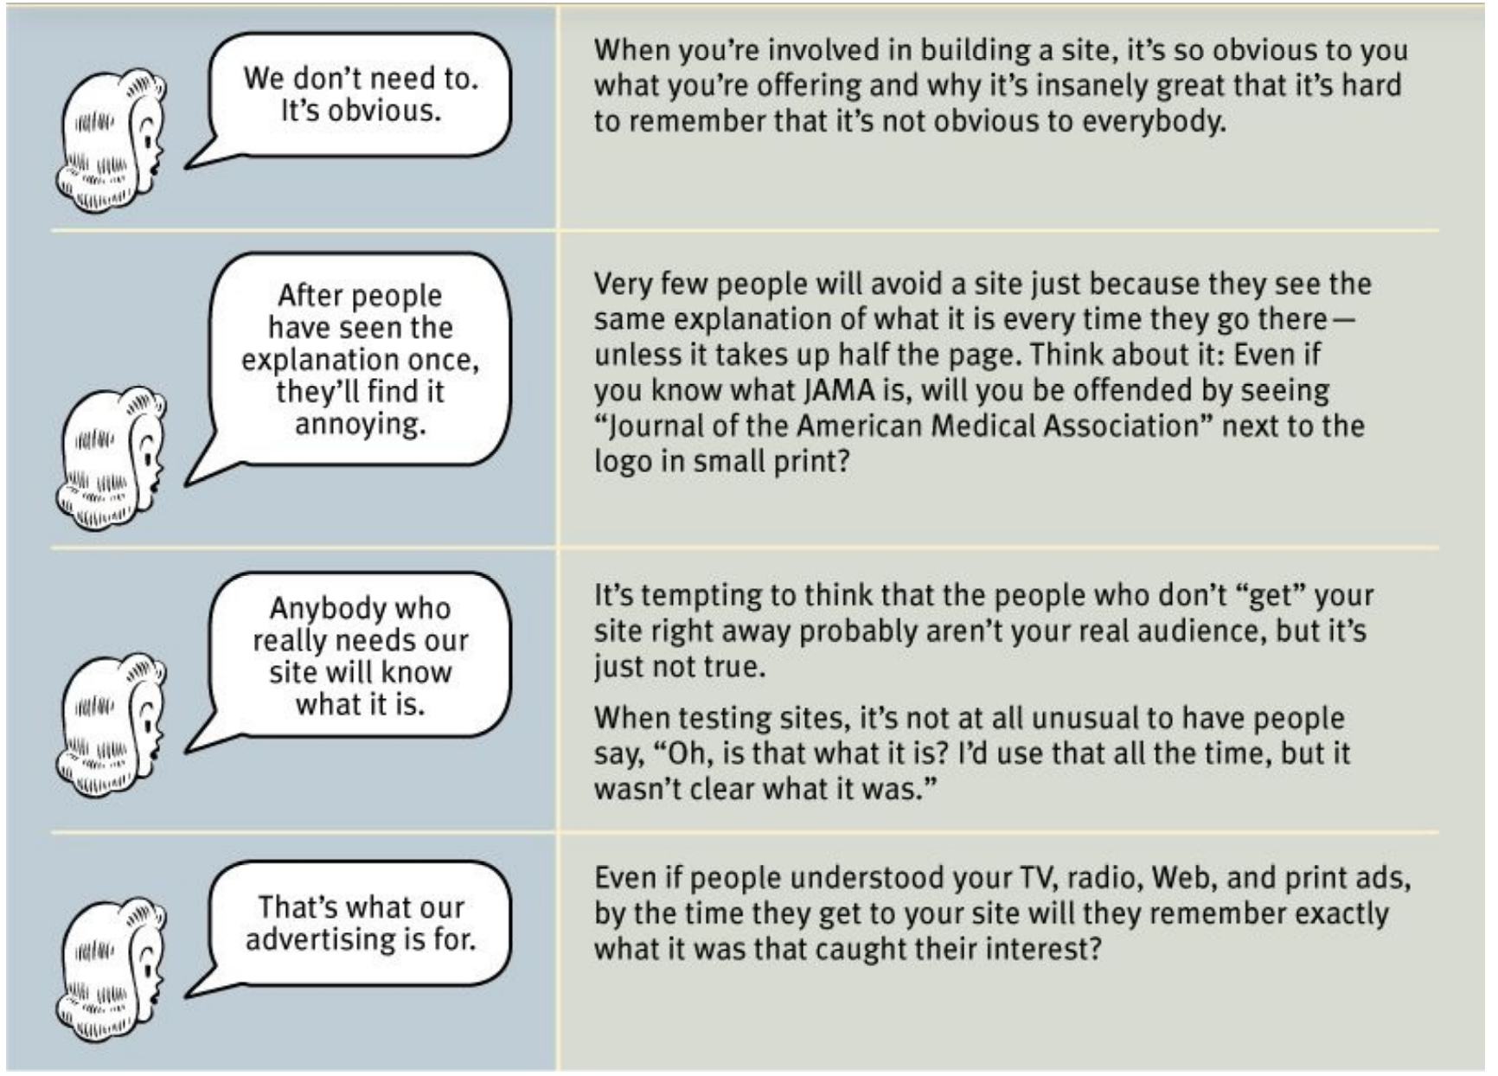
Top Four Plausible Excuses

Slide 26
But...the Home page? Really?
“Nobody enters a site through the Home page anymore. That’s so 2004.”
People will teleport into the depths of a site and look at the page the link took them to.
Very often, though, the next thing they’ll do is visit the Home page to get their bearings (think of it as divers bobbing up to the surface to see where they are.)
If the page they went to was interesting, they want to see what else is on the site.
If it contained information they need to rely on, they may want to find out who publishes it, and how credible it is.
The Home page is still the place where this happens, and you need to do it well

Slide 27
How to get the message across
3 important places:
The tagline
The Welcome blurb.
The “Learn more.”
Guidelines:
Use as much space as necessary.
...but don’t use any more space than necessary
Don’t use a mission statement as a Welcome blurb.
It’s one of the most important things to test

Slide 28
Nothing beats a good tagline!™
clear and informative
just long enough, but not too long
convey differentiation & clear benefit
Bad taglines sound generic.
Good taglines are personable, lively, and sometimes clever
Some sites can get by without a tagline:
The relative handful of sites that have already achieved household word status.
Sites that are very well known from their offline origins.

Slide 29
The fifth question
When I enter a new site, after a quick look around the Home page I should be able to say with confidence:
Here’s where to start if I want to search.
Here’s where to start if I want to browse.
Here’s where to start if I want to sample their best stuff.
Kill the Golden Geese:
Preserving the Home page from promotional overload requires constant vigilance, since it usually happens gradually, with the slow, inexorable addition of just...one...more...thing.
All the stakeholders need to be educated about the danger of overgrazing the Home page and offered other methods of driving traffic, like cross-promoting from other popular pages or taking turns using the same space on the Home page

Slide 30
Homework
Don’t make me think! : to chapter 7 (at least)
Speed up assignment 1.

